Slide 1
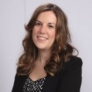
Wicked Wiki
Recognizing the Value of Wikipedia as a Resource
Samantha Dodd, C.A.
Special Collections, UT Arlington Libraries

Slide 2
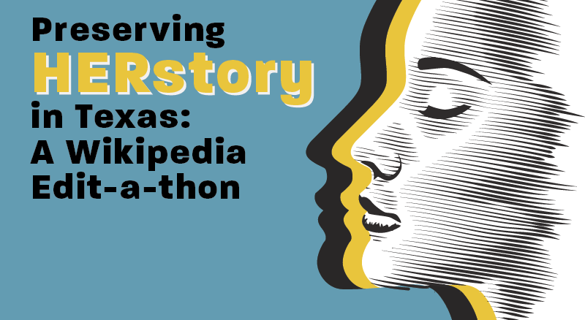
Project Overview
Outreach
Open Access Week programming: Wikipedia in the Classroom
Collaboration
Women and Gender Studies partnership
4 Courses utilized Wikipedia assignment (Spring 2018)
Staff Development
Wikipedia + Libraries Better Together Training Program
Edit-a-thon
HERstory edit-a-thon (March 28, 2018)

Slide 3
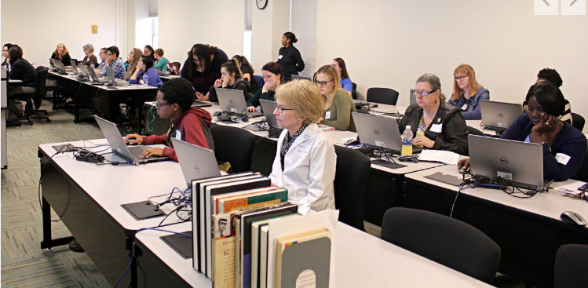
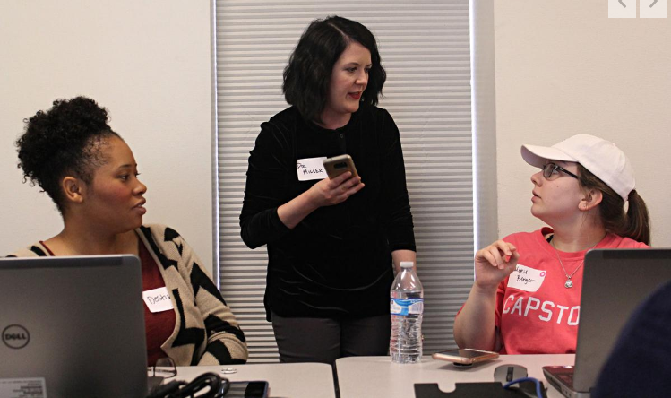
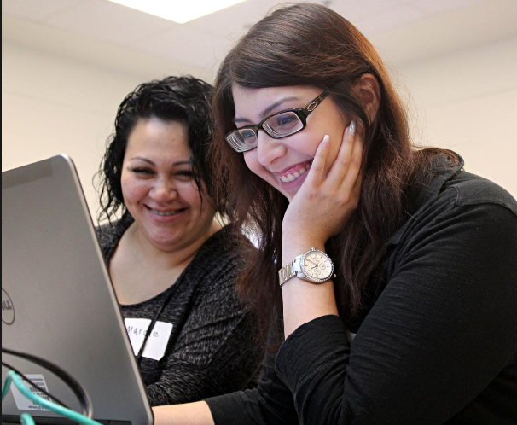
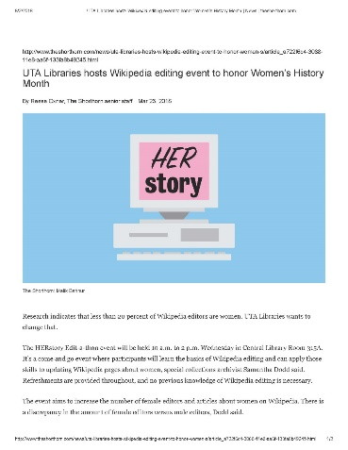
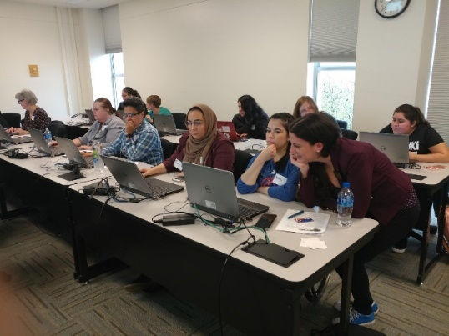
Results
HERstory Edit-a-thon
Articles edited: 59
Articles create: 2
Total edits: 231
Editors: 62
Words added: 10.6K
Article Views: 579K

Slide 4
Why Wiki?
Ideological
Mission alignment: Freely get information to people who need it.
Librarians need to be part of this project and help shape it.
Ethical
Bring diversity and inclusion to Wikipedia
Logical
Some skills improved by using Wikipedia related assignments: research, writing,
identifying and evaluating sources, language, technology…
Practical
Wikipedia is the 5th most visited website in the world
Notes:
Less than 10% of Wikipedians contribute over 90% of
the total number of contributions on the English Wikipedia
(Ortega,
Gonzalez-Barahona, & Robles, 2008)
less than 20 percent of Wikipedia editors are female
Only 15% of the biographies on Wikipedia are about women

Slide 5
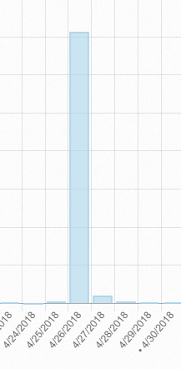
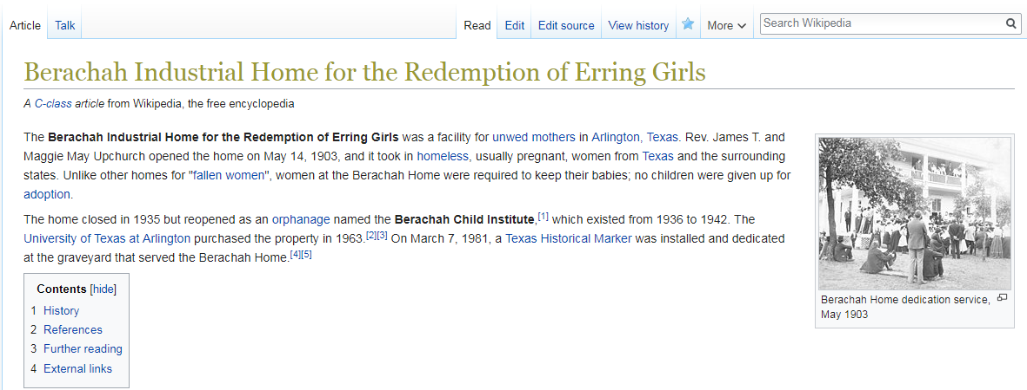
Why Wiki?
Extending our reach: Accessibility and Discoverability

Slide 6
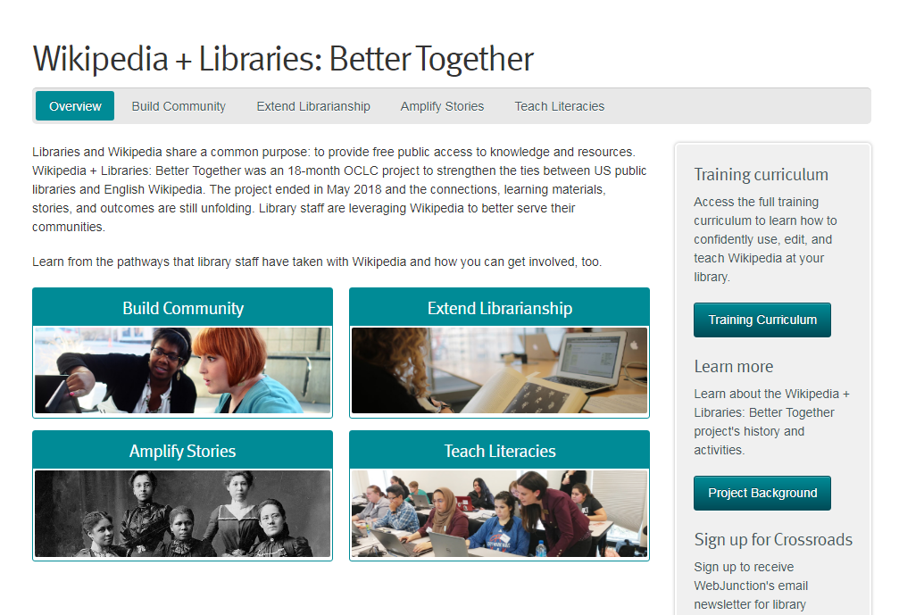
Useful links for librarians and archivists
Training Modules from Wiki Education
Wikipedia Essentials, Editing Basics, Evaluating Articles and Sources, Finding your article,
Sandboxes and Mainspace, Contributing Media
The Wikipedia Library
The Wikipedia Library helps editors access reliable sources to improve Wikipedia. We also help knowledge professionals share their collections with the public.
GLAM-Wiki initiative
The GLAM-Wiki initiative ("galleries, libraries, archives, and museums" with Wikipedia;) helps cultural
institutions share their resources with the world through collaborative projects with experienced
Wikipedia editors.
Teahouse
a friendly place to learn about editing Wikipedia.
Wikipedia + Libraries: Better Together (Training Program)
Access the full training curriculum to learn how to confidently use, edit, and teach
Wikipedia at your library.

Slide 7
Need help? Just ask!
Samantha Dodd
Email: samantha.dodd@uta.edu
Phone: 817-272-7047
Wikipedia: Doddsam09

